Slide 1
Design principles and guidelines
Broad usability statements that guide a developer’s design efforts
Derived from common design problems across many systems

Slide 2
Guidelines
Visibility
Simple and natural dialogue
Speak the user’s language
Minimize user's memory load
Be consistent
Give user control and freedom
Support undo
Provide shortcuts
Deal with errors in a positive way
Provide help

Slide 3
Guidelines:
1. Visibility

Slide 4
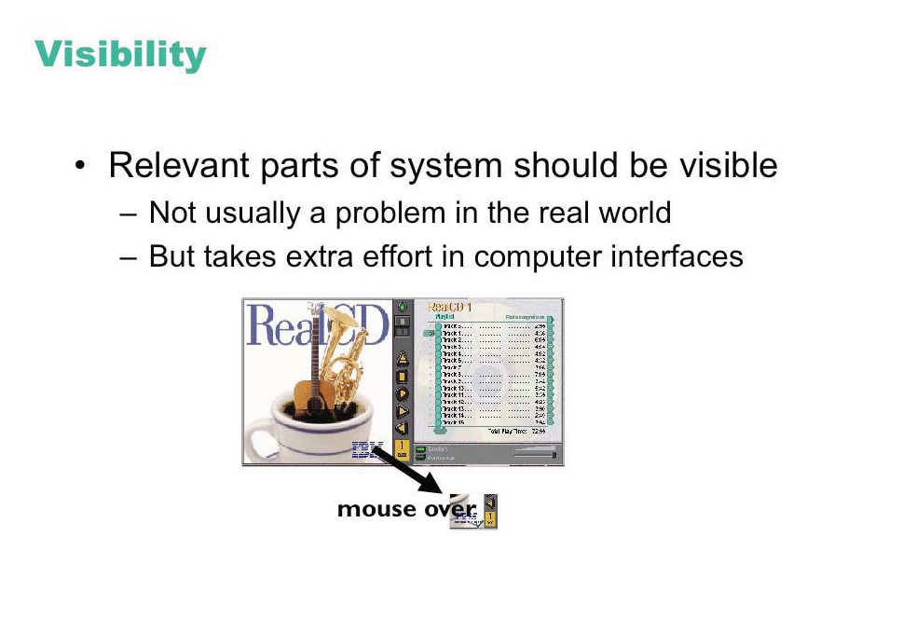
© IBM

Slide 5
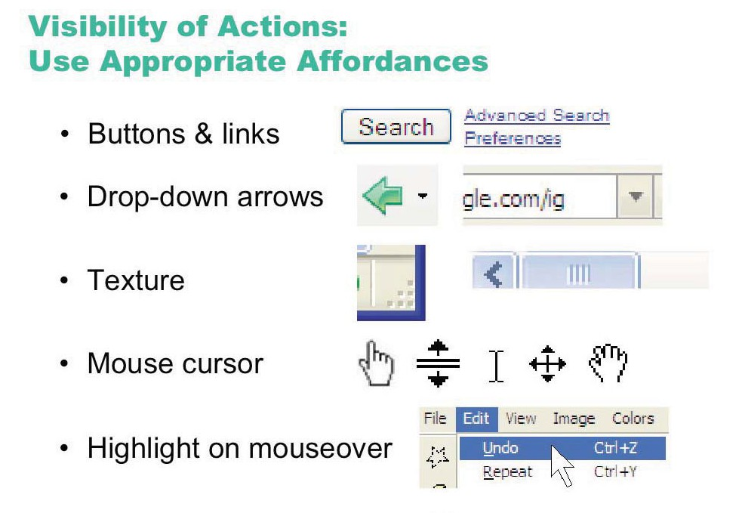
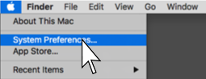

Slide 6
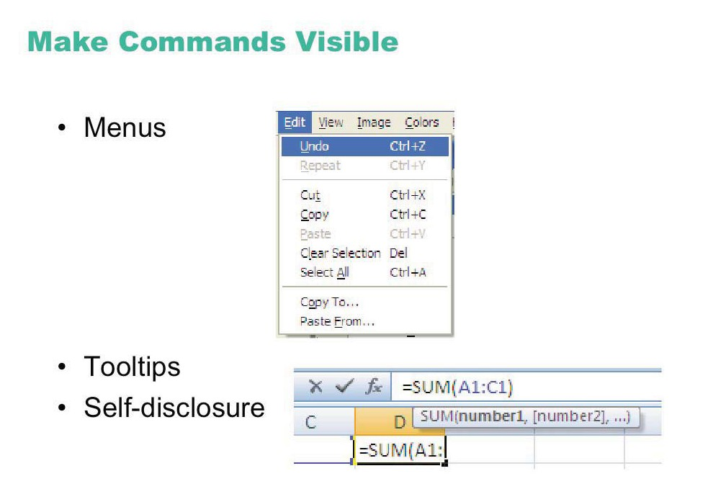
© Microsoft

Slide 7
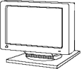
Provide feedback
Continuously inform the user about
what it is doing
how it is interpreting the user’s input
user should always be aware of what is going on
What’s it doing?
Time for coffee.
> Doit
> Doit
This will take 5 minutes...

Slide 8
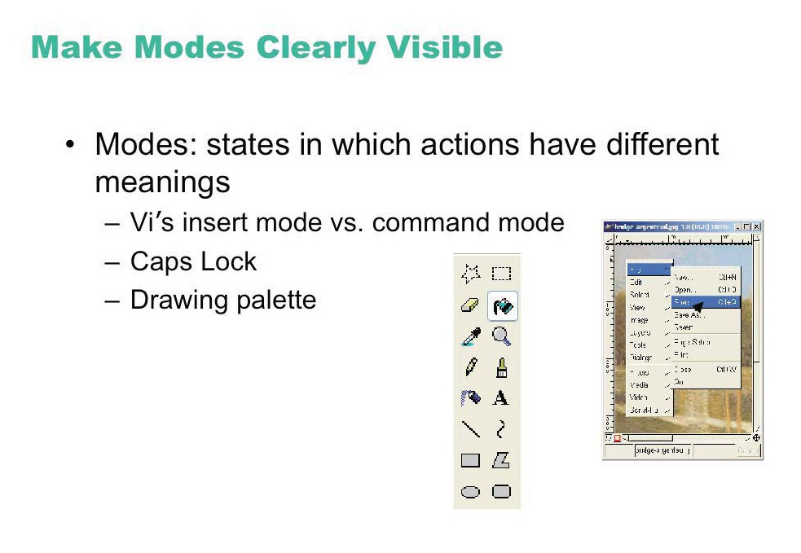
© The GIMP Team
© Microsoft

Slide 9
Provide feedback
What mode am I in now?
What did I select?
How is the system interpreting my actions?
Microsoft Paint

Slide 10
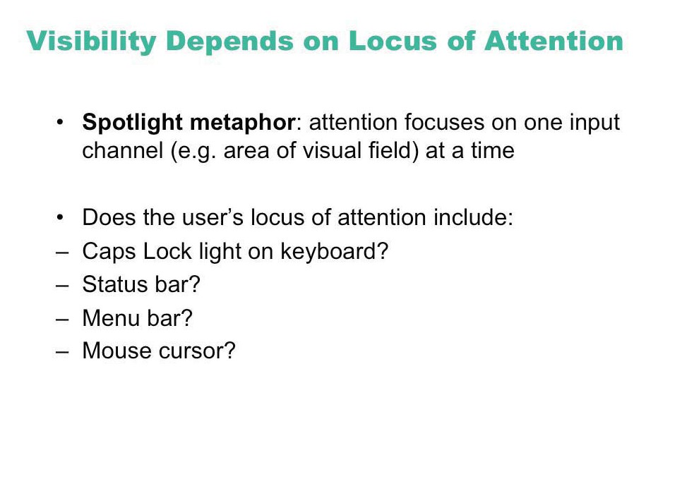

Slide 11
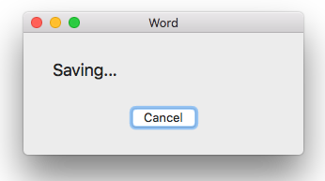
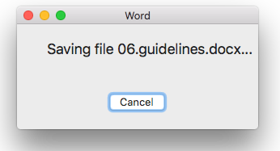
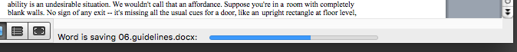
Provide feedback
Be as specific as possible, based on user’s input Best within the context of the action

Slide 12
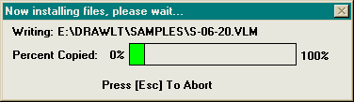
Provide feedback
Multiple files being copied, but feedback is file by file.
Drawing Board LT

Slide 13
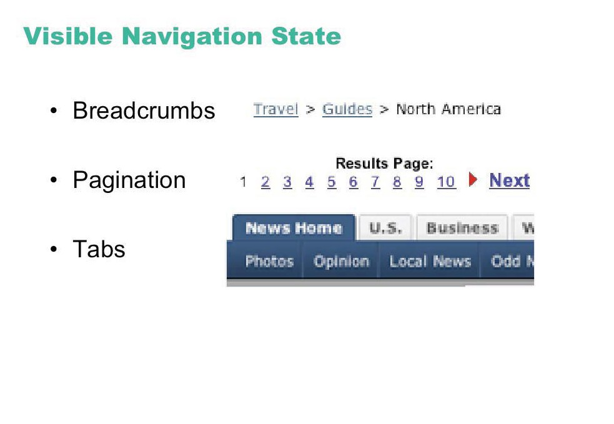

Slide 14
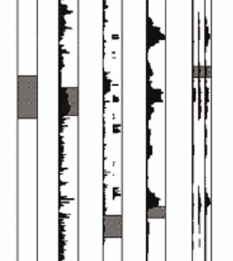
Read wear/Edit wear
Scrollbar shows extra information, but takes no extra space
Predecessor of modern social navigaion/recommender system
James Hollan

Slide 15
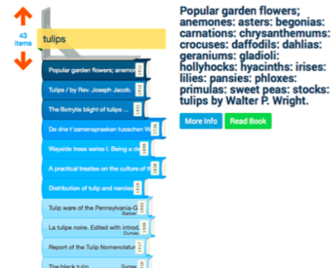
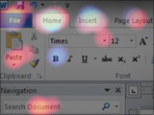
More Recent Examples
Harvard Stacklife
Matejka et al, Patina
http://www.youtube.com/watch?v=Tz3MtN89gSQ
http://www.youtube.com/watch?v=PuMw0CR_FYI

Slide 16
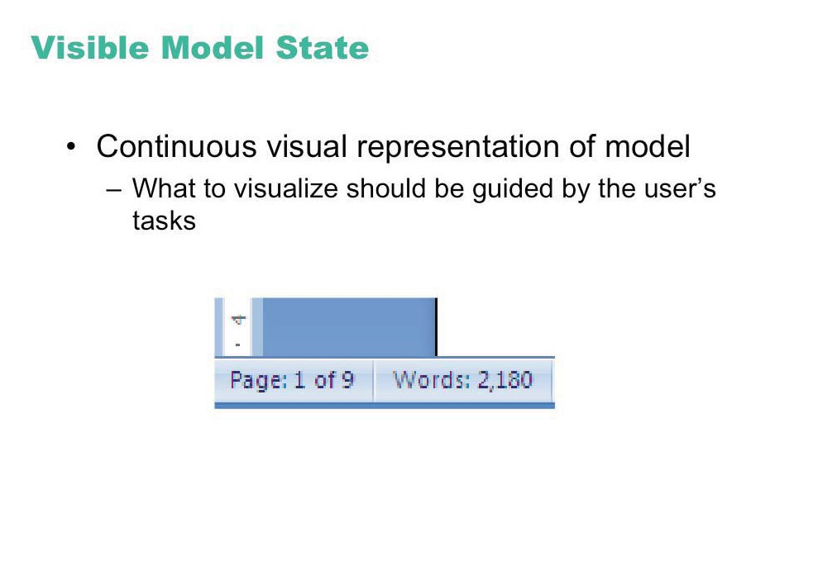
© Microsoft

Slide 17
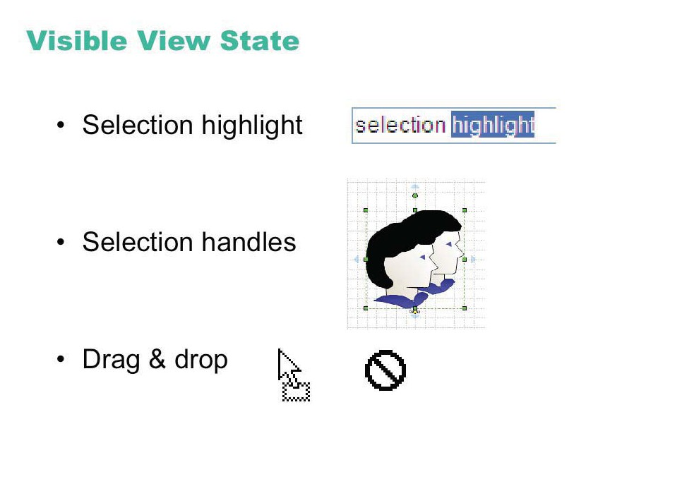

Slide 18
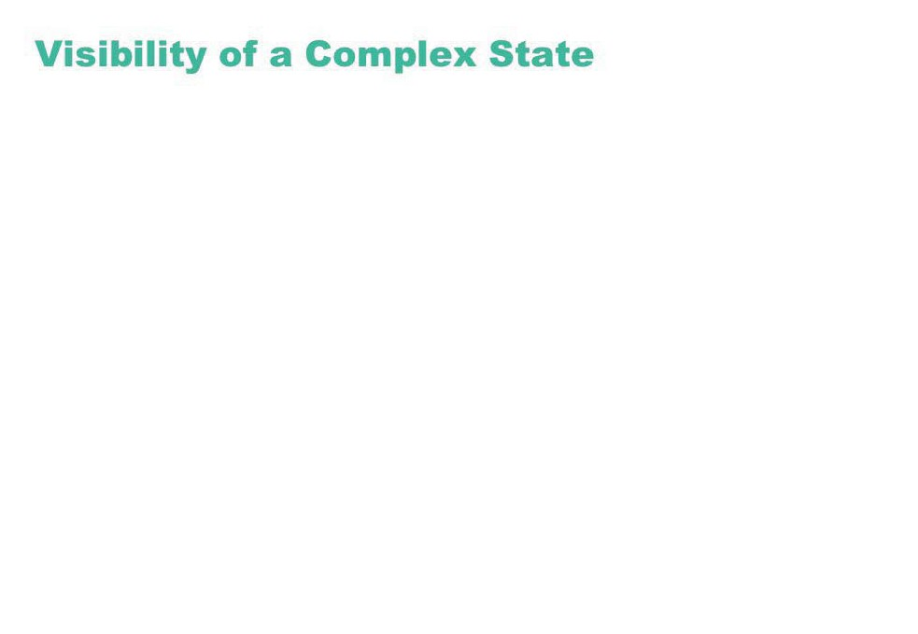
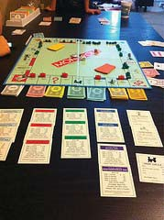
Image courtesy of James Fleeting on Flickr.

Slide 19
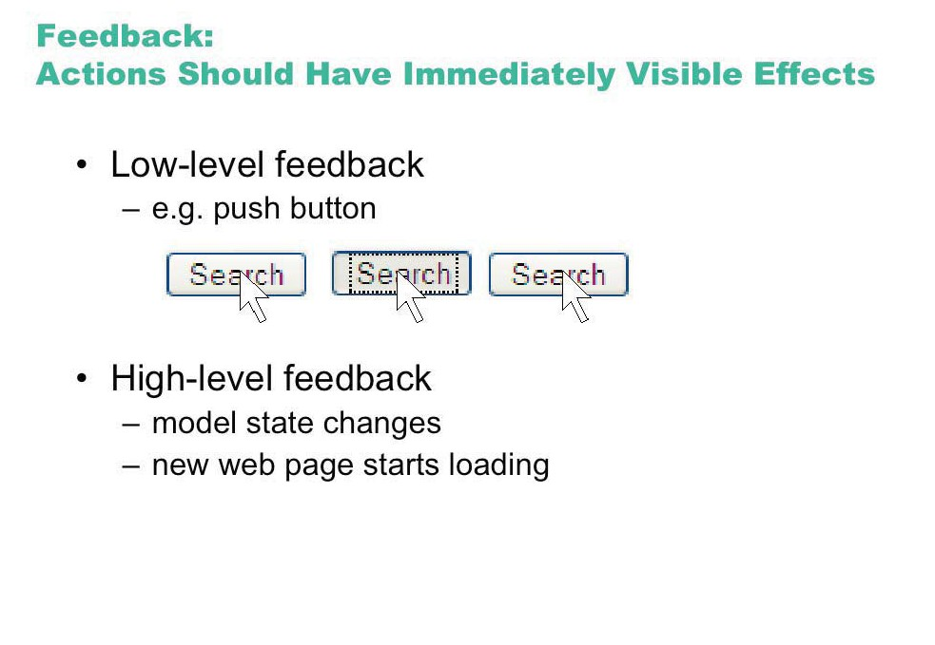

Slide 20
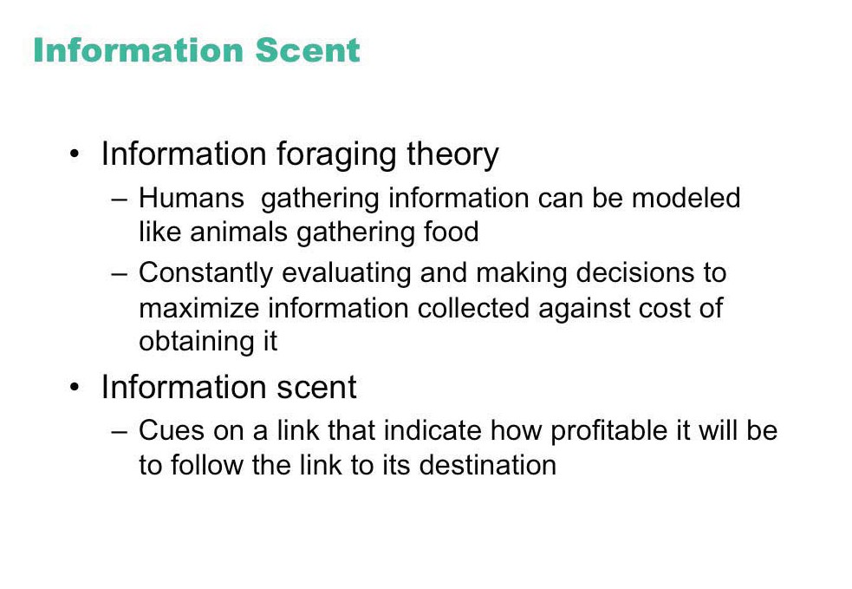

Slide 21
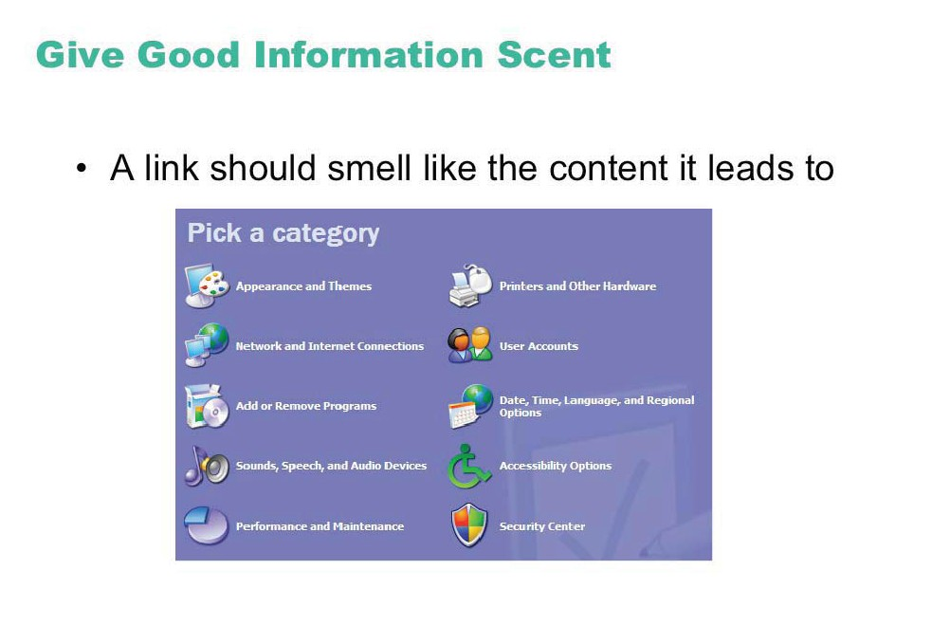
© Microsoft

Slide 22
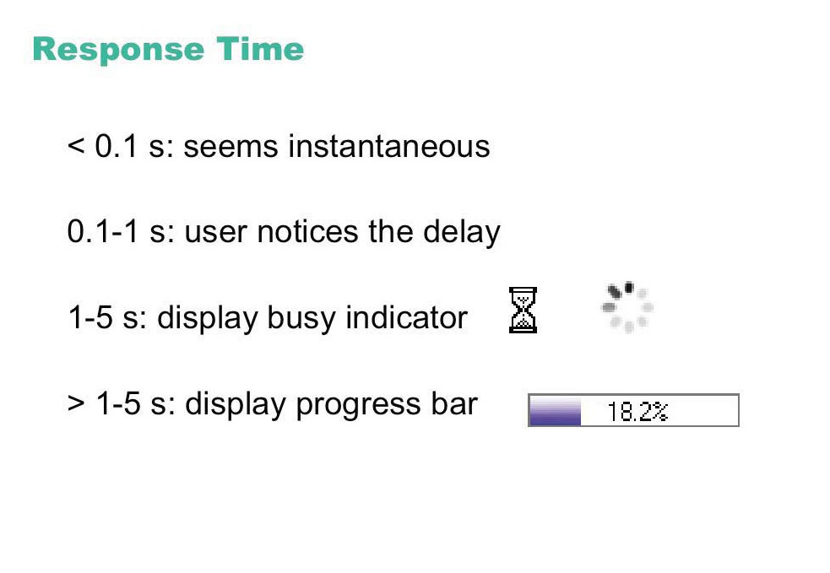

Slide 23
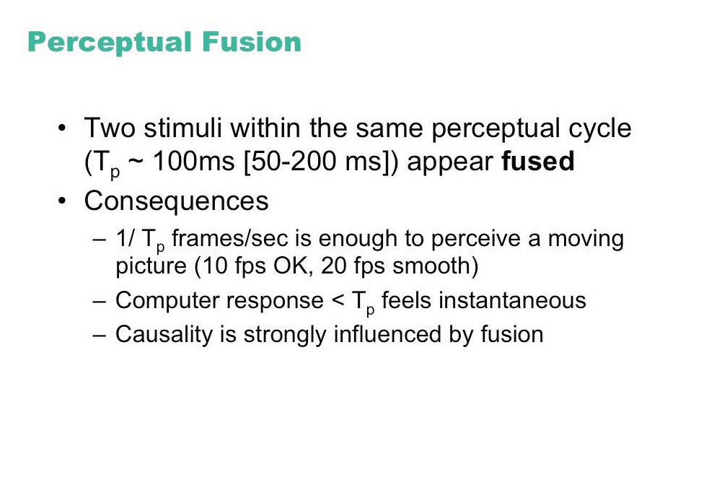

Slide 24
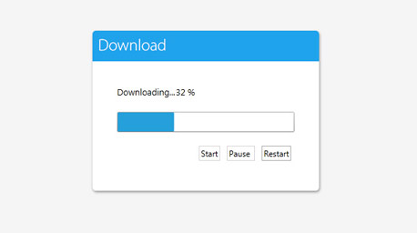
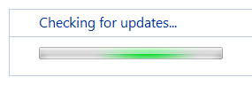
Dealing with long delays
Cursors
for short transactions
Percent done dialogs
time left
estimated time
Random
for unknown times

Slide 25
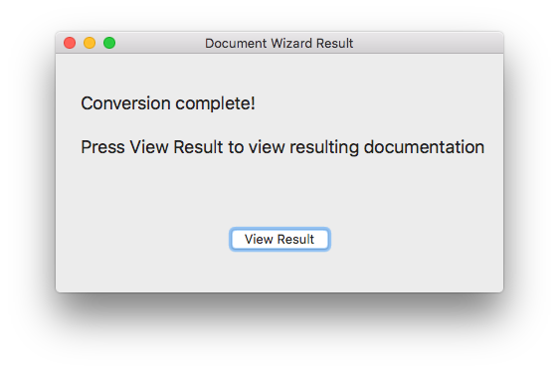
Unnecessary Feedback
Original source: Interface Hall of Shame

Slide 26
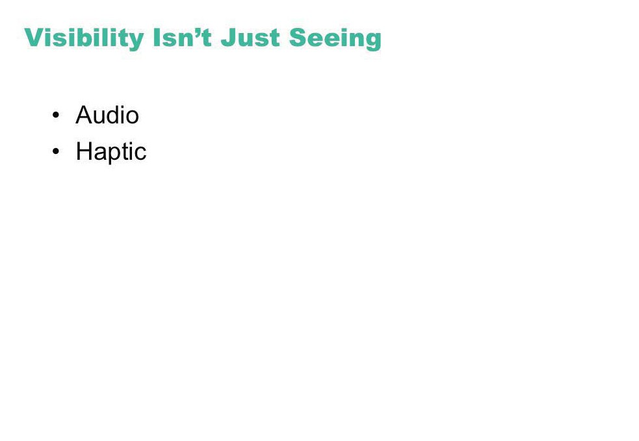

Slide 27
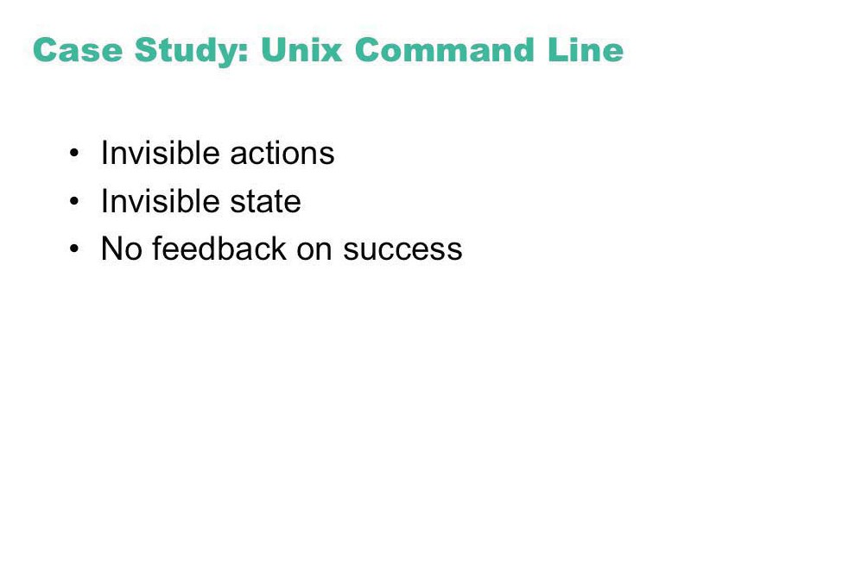

Slide 28
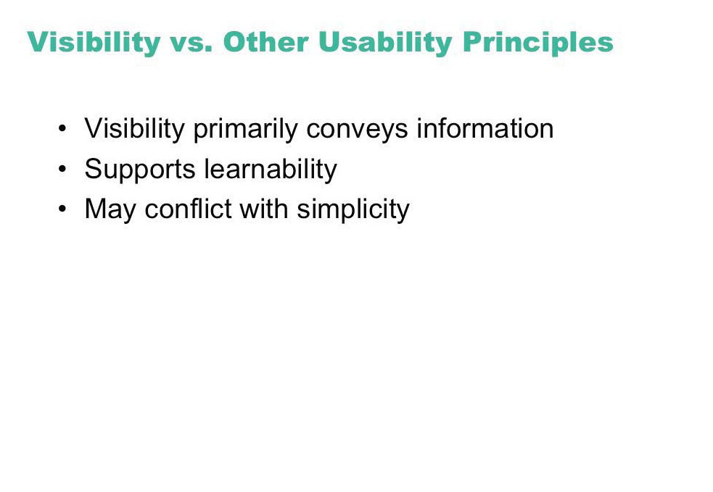

Slide 29
Guidelines:
2. Simple and Natural Dialogue

Slide 30
Simple and natural dialogue
Use the user’s mental model
Match the users’ task sequence
Minimize mapping between interface and task semantics

Slide 31
Simple and natural dialogue
Present exactly the information the user needs
less is more
less to learn, to get wrong, to distract...
information should appear in natural order
related information is graphically clustered
order of accessing information matches user’s expectations
remove or hide irrelevant or rarely needed information
competes with important information on screen
remove modes
use windows frugally
don’t add unneeded navigation and window management

Slide 32
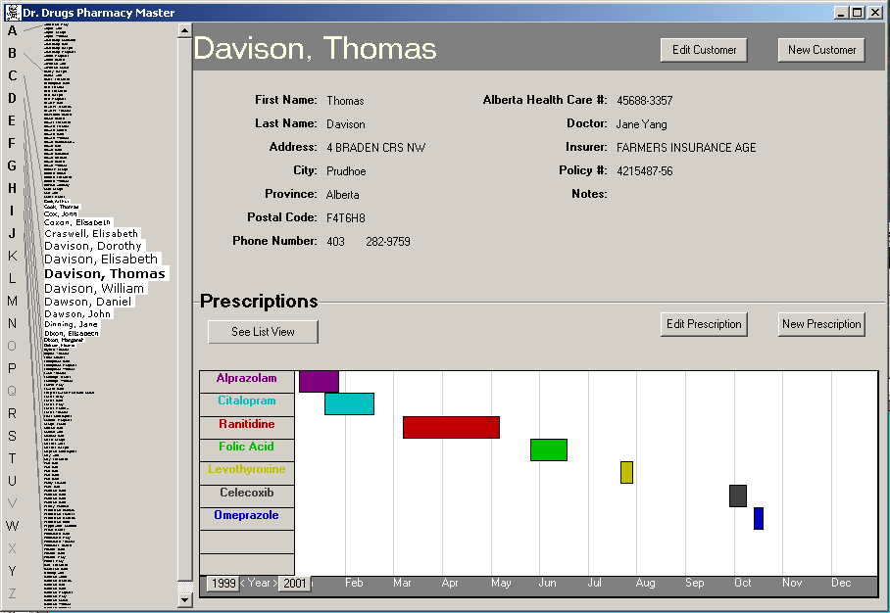
Good: information all in the same place
By previous 481 students Brant LeClercq, Lloyd Yoon, Amy Yang (with permission)

Slide 33
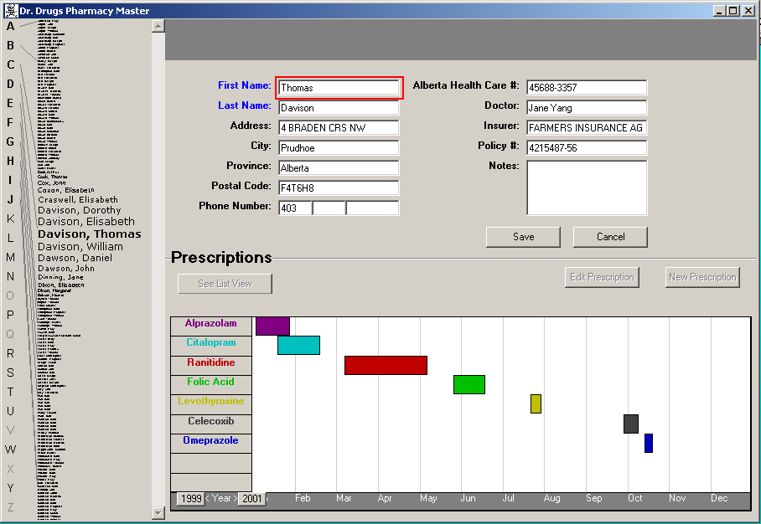
Good: information all in the same place Bad: special edit mode
By previous 481 students Brant LeClercq, Lloyd Yoon, Amy Yang (with permission)

Slide 34
By previous 481 students Brant LeClercq, Lloyd Yoon, Amy Yang (with permission)

Slide 35
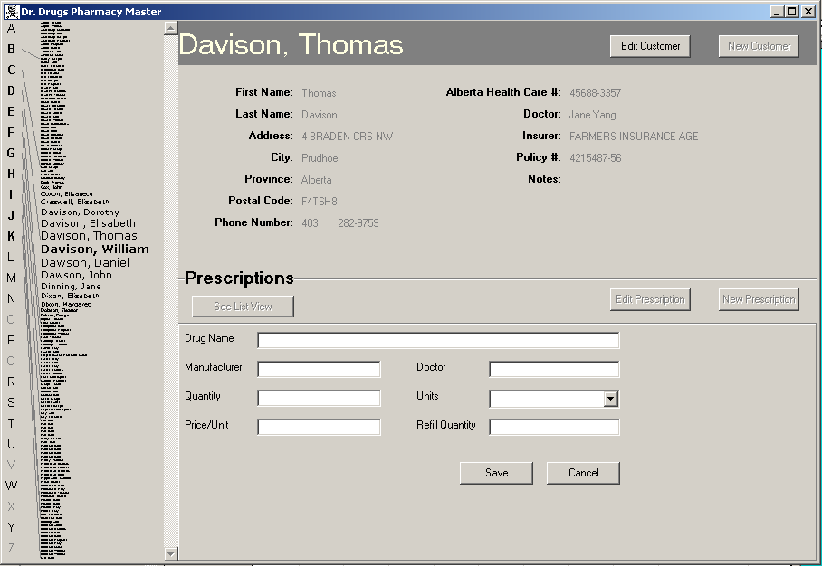
Good: Stable parts of the window Bad: Prescriptions separate from graphics
By previous 481 students Brant LeClercq, Lloyd Yoon, Amy Yang (with permission)

Slide 36
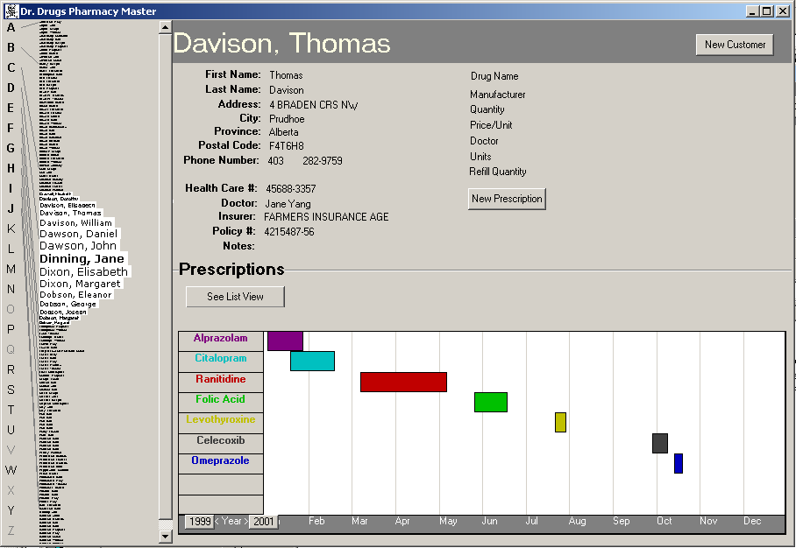
collapsed onto one screen (needs formatting)
Click to get info
Double click to edit (mode buttons gone)
Add Undo
By previous 481 students Brant LeClercq, Lloyd Yoon, Amy Yang (with permission)

Slide 37
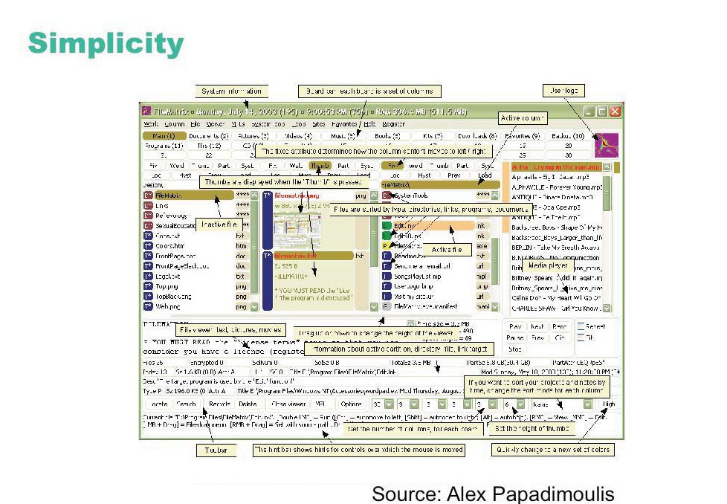
© FileMatrix

Slide 38
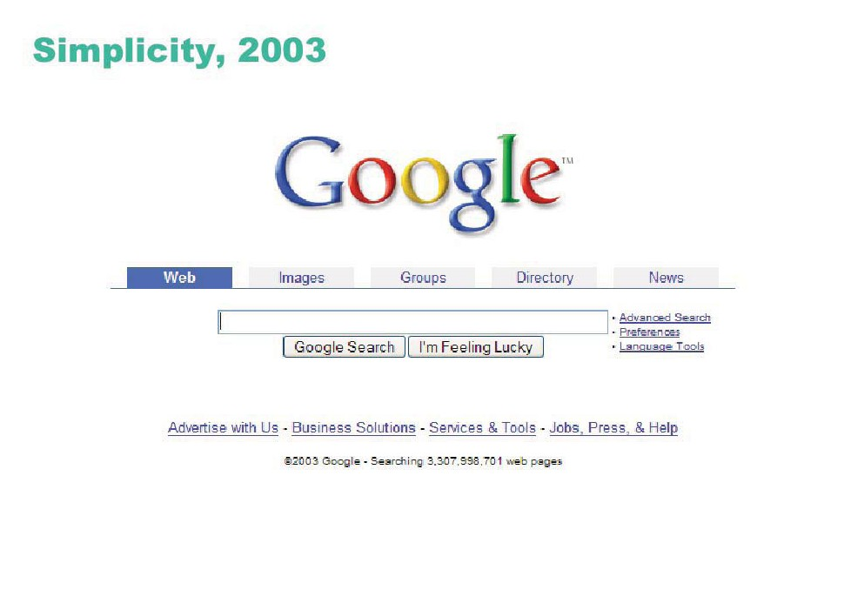
© Google Inc.

Slide 39
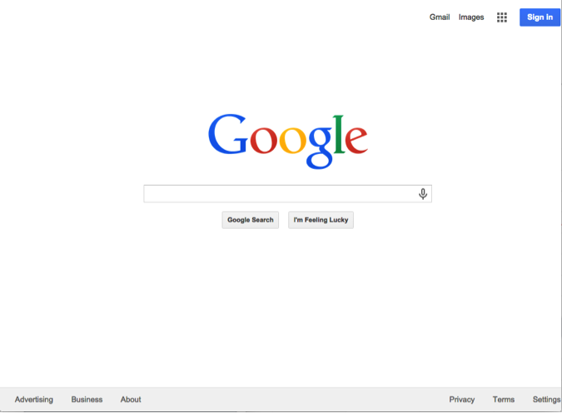
Techniques: Remove nonessential elements
© Google Inc.

Slide 40
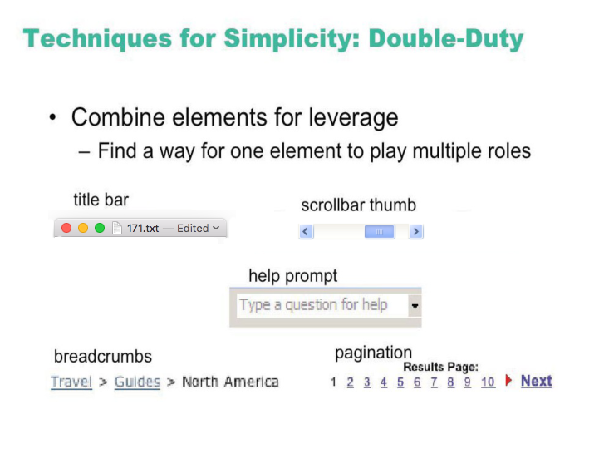

Slide 41
Guidelines:
3. Speak the User’s Language

Slide 42
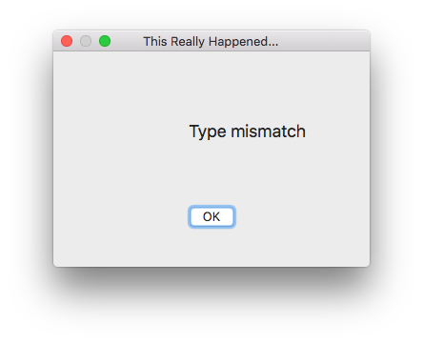

Speak the User’s Language
Use common words, not technical jargon
But use domain-specific terms where appropriate
Allow aliases/synonyms in command languages
Original source: Interface Hall of Shame

Slide 43
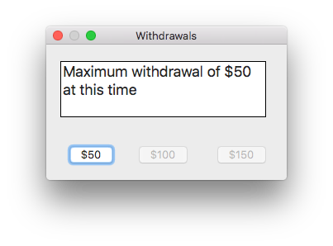
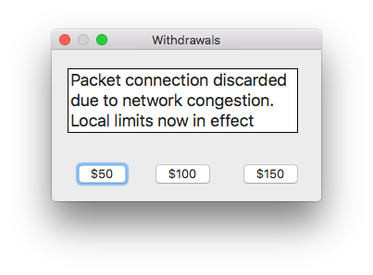
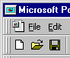
Speak the user’s language
Terminology based on users’ language for task
e.g. withdrawing money from a bank machine
Use meaningful mnemonics, icons & abbreviations
eg File / Save
Ctrl + S (abbreviation)
Alt FS (mnemonic for menu action)
(tooltip icon)

Slide 44
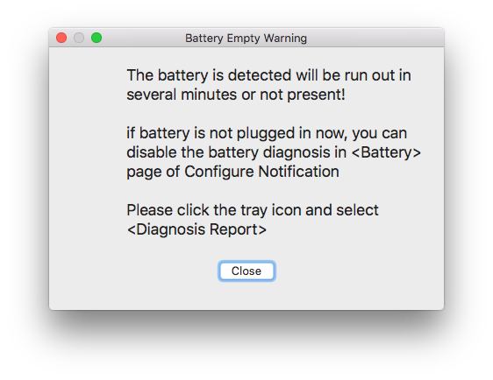
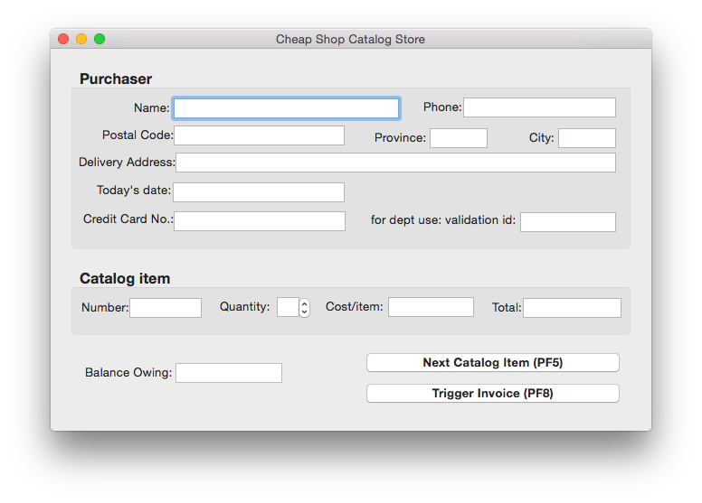
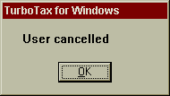
Speak the users’ language

Slide 45
Guidelines:
4. Minimize User’s Memory Load

Slide 46
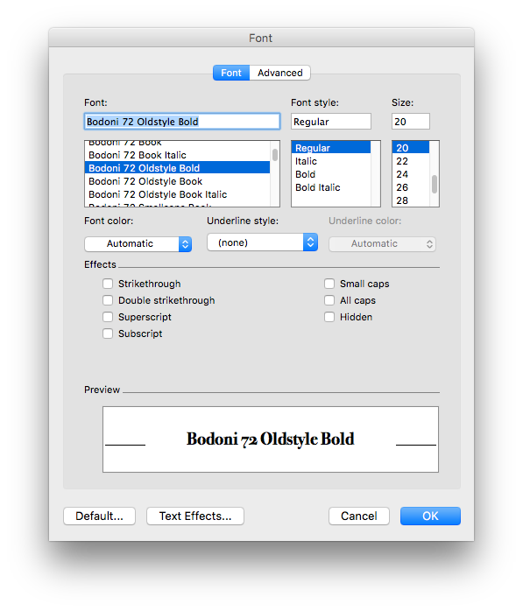
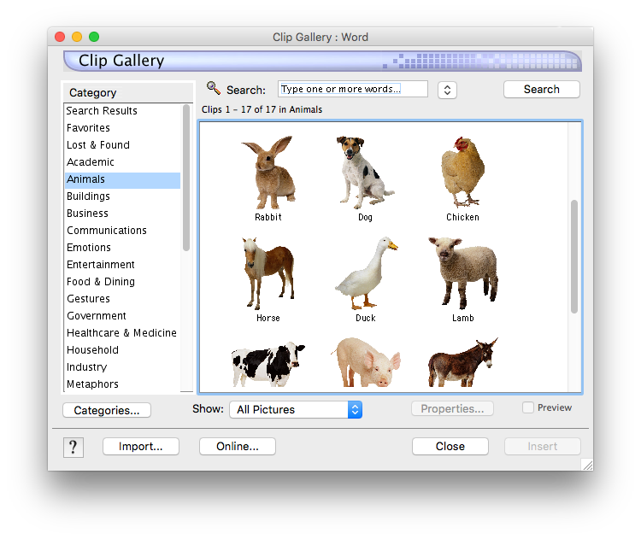
Minimize user’s memory load
Computers good at remembering, people are not!
Promote recognition over recall
menus, icons, choice dialog boxes vs commands, field formats
relies on visibility of objects to the user (but less is more!)
From Microsoft applications

Slide 47
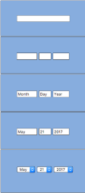
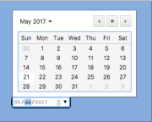
Minimize user’s memory load
Gives input format, example and default

Slide 48
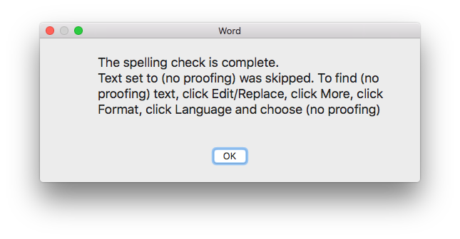

People Don’t Learn Instantly
Original source: Interface Hall of Shame

Slide 49

Inane Dialog Boxes
Midwest Microwave's online catalog
Some of these interfaces were posted on Interface Hall of Shame

Slide 50
Guidelines:
5. Be Consistent

Slide 51


Slide 52
Be consistent
Consistent syntax of input
Consistent language and graphics
same visual appearance across the system (e.g. widgets)
same information/controls in same location on all windows
Consistent effects
commands, actions have same effect in equivalent situations
predictability
Ok
Cancel
Cancel
Ok
Ok
Accept
Dismiss
Cancel

Slide 53




© The GIMP Team. All rights reserved.
© Remember the Milk. All rights reserved.

Slide 54

Be Consistent
These are labels with a raised appearance.
Is it any surprise that people try and click on them?

Slide 55


From Peachpit website

Slide 56

© Microsoft

Slide 57


Slide 58
Guidelines:
6. Give User Control and Freedom

Slide 59


Slide 60


© GlobalSCAPE, Inc.

Slide 61
Provide clearly marked exits
Users don’t like to feel trapped by the computer!
should offer an easy way out of as many situations as possible
Strategies:
Cancel button (for dialogs waiting for user input)
Universal Undo (can get back to previous state)
Interrupt (especially for lengthy operations)
Quit (for leaving the program at any time)
Defaults (for restoring a property sheet)
Core
Dump

Slide 62

Provide clearly marked exits
How do I get out of this?

Slide 63


Wizard vs. Center Stage: Who’s in Control?

Slide 64


© Google.

Slide 65



Slide 66


Slide 67

© Facebook

Slide 68
Guidelines:
7. Support Undo

Slide 69

© Apple Inc. All rights reserved.
© Google. All rights reserved.
© Wikipedia Foundation, Inc.

Slide 70


Slide 71


Slide 72


Slide 73


Slide 74


Slide 75


Slide 76


Slide 77
Guidelines:
8. Provide Shortcuts

Slide 78

Provide shortcuts
Keyboard accelerators for menus
Customizable toolbars and palettes for frequent actions
Split menu, with recently used fonts on top
Double-click raises toolbar dialog box
Double-click raises object-specific menu
Scrolling controls for page-sized increments
Microsoft Powerpoint

Slide 79

Provide shortcuts
Alternate representation for quickly doing different set of tasks
Toolset brought in appropriate to this representation
Microsoft Powerpoint

Slide 80
Guidelines:
9. Deal with Errors in a Positive Way

Slide 81

Deal with errors in a positive way
What is “error 15762”?

Slide 82


Slide 83


Slide 84


Slide 85
Mode Error
Modes : states in which same actions have different meanings
vi insert mode vs. command mode
Caps lock
Drawing tool palette

Slide 86


Slide 87

© Microsoft

Slide 88


Slide 89


Slide 90


Slide 91



%
© Microsoft

Slide 92



Slide 93

Problematic message to a nuclear power plant operator

Slide 94



Deal with errors in a positive way
Adobe's ImageReady
Windows Notepad
Microsoft's NT Operating System

Slide 95

© Apple, Inc
© Microsoft
© Autodesk, Inc.

Slide 96


Slide 97

© Adobe Systems Inc.

Slide 98
Provide meaningful error messages
error messages should be in the user’s task language
don’t make people feel stupid
Try again, bonehead!
Error 25
Cannot open this document
Cannot open “chapter 5” because the application “Microsoft Word” is not on your system
Cannot open “chapter 5” because the application “Microsoft Word” is not on your system. Open it with “TextEdit” instead?

Slide 99


Deal with errors in a positive way
Prevent errors
try to make errors impossible
widgets where you can only enter legal data
Provide reasonableness checks on input data
on entering order for office supplies
5000 pencils is an unusually large order. Do you really want to order that many?

Slide 100




Inane Dialog Boxes
Umm, thanks for the warning,
but what should I do?
What happens when you cancel a cancelled operation?
Do I have any choice in this?
Uhhh… I give up on this one
Some of these interfaces were posted on Interface Hall of Shame

Slide 101



Inane Dialog Boxes
These are too good not to show
Some of these interfaces were posted on Interface Hall of Shame

Slide 102




Inane Dialog Boxes
ClearCase, source-code control Rational Software
Some of these interfaces were posted on Interface Hall of Shame

Slide 103

One More Example

Slide 104
Guidelines:
10. Provide Help

Slide 105
Provide help
Help is not a replacement for bad design!
Simple systems:
walk up and use; minimal instructions
Most other systems
feature rich
simple things should be simple
learning path for advanced features
Volume 37:
A user's
guide to...

Slide 106
Documentation and how it is used
Many users do not read manuals
prefer to spend their time pursuing their task
Usually used when users are in some kind of panic
paper manuals often unavailable or inaccessible
online documentation better
good search/lookup tools
online help specific to current context
Sometimes used for quick reference
syntax of actions, possibilities...
list of shortcuts ...

Slide 107
Types of help
Tutorial and/or getting started manuals
short guides that people are likely to read when first obtaining their systems
encourages exploration and getting to know the system
tries to get conceptual material across and essential syntax
on-line “tours”, exercises, and demos
demonstrates very basic principles through working examples

Slide 108


Types of help
Reference manuals
used mostly for detailed lookup by experts
rarely introduces concepts
thematically arranged
on-line hypertext
search / find
table of contents
index
cross-index

Slide 109
Types of help
Reminders
short reference cards
expert user who just wants to check facts
novice who wants to get overview of system’s capabilities
keyboard templates
shortcuts/syntactic meanings of keys; recognition vs. recall; capabilities
tooltips and other context-sensitive help
text over graphical items indicates their meaning or purpose
Microsoft Word

Slide 110

Types of help
Wizards
walks user through typical tasks
but dangerous if user gets stuck
What’s my computer’s name? Fred? Intel? Dell?
Microsoft Powerpoint

Slide 111


Types of help
Tips
migration path to learning system features
also context-specific tips on being more efficient
must be “smart”, otherwise boring and tedious
Microsoft Word

Slide 112
Summary of Guidelines
Visibility
Simple and natural dialogue
Speak the user’s language
Minimize user's memory load
Be consistent
Give user control and freedom
Support undo
Provide shortcuts
Deal with errors in a positive way
Provide help

Slide 113


Slide 114
Heuristic evaluation
Compare UI design to guidelines
Issues
Problems found by a single inspector
Problems found by multiple inspectors
Individuals vs. teams
Self guided or scenarios?

Slide 115
Problems found by one inspector
Average over six case studies
35% of all usability problems;
42% of the major problems
32% of the minor problems
Not great, but
finding some problems with one evaluator is much better than finding no problems with no evaluators!

Slide 116
Problems found by one inspector
Varies according to
difficulty of the interface being evaluated
the expertise of the inspectors
Average problems found by:
novice evaluators - 22%
no usability expertise
regular specialists - 41%
expertise in usability
double specialists - 60%
experience in both usability and the particular kind of interface being evaluated
also find domain-related problems
Tradeoff
novices poorer, but cheaper!

Slide 117

Problems found by one inspector
Evaluators miss both easy and hard problems
‘best’ evaluators can miss easy problems
‘worse’ evaluators can discover hard problems

Slide 118

Problems found by multiple evaluators
3-5 evaluators find 66-75% of usability problems
different people find different usability problems
only modest overlap between the sets of problems found

Slide 119

Problems found by multiple evaluators
Where is the best cost/benefit?

Slide 120
Individuals vs teams
Nielsen
recommends individual evaluators inspect the interface alone
Why?
evaluation is not influenced by others
independent and unbiased
greater variability in the kinds of errors found
no overhead required to organize group meetings

Slide 121
Self Guided vs Scenario Exploration
Self-guided
open-ended exploration
Not necessarily task-directed
good for exploring diverse aspects of the interface, and to follow potential pitfalls
Scenarios
step through the interface using representative end user tasks
ensures problems identified in relevant portions of the interface
ensures that specific features of interest are evaluated
but limits the scope of the evaluation - problems can be missed

